Slide 1

NSG Pilkington – University of Liverpool Machine Learning Project: 16/12/2020
Dr. Peter Green
Diego Echeverria
Risk Institute,
School of Engineering

Slide 2
List of activities
Implement percentage threshold for eliminating non-relevant tags using the Linear Regression (autoregressive) parameters
Run the Linear Regression (autoregressive) model after eliminating correlated tags
Expand to validation data set
Video with the faults density on top of the predictions
Comprehensive list of pre-processing parameters that could be tuned

Slide 3
List of activities
Implement percentage threshold for eliminating non-relevant tags using the Linear Regression (autoregressive) parameters
Run the Linear Regression (autoregressive) model after eliminating correlated tags
Video with the faults density on top of the predictions
Expand to validation data set
Comprehensive list of pre-processing parameters that could be tuned

Slide 4
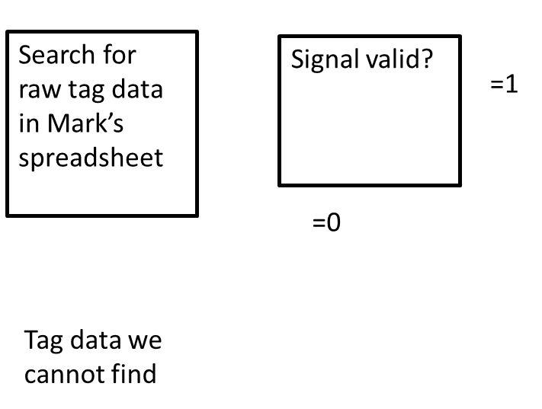
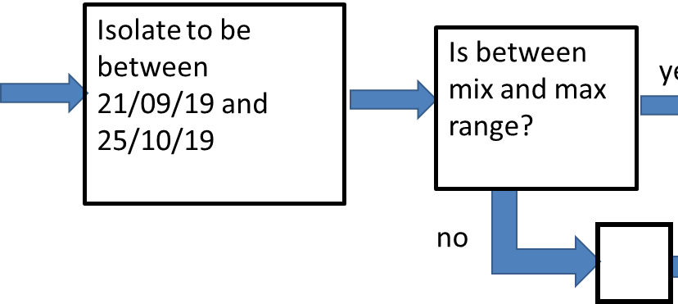
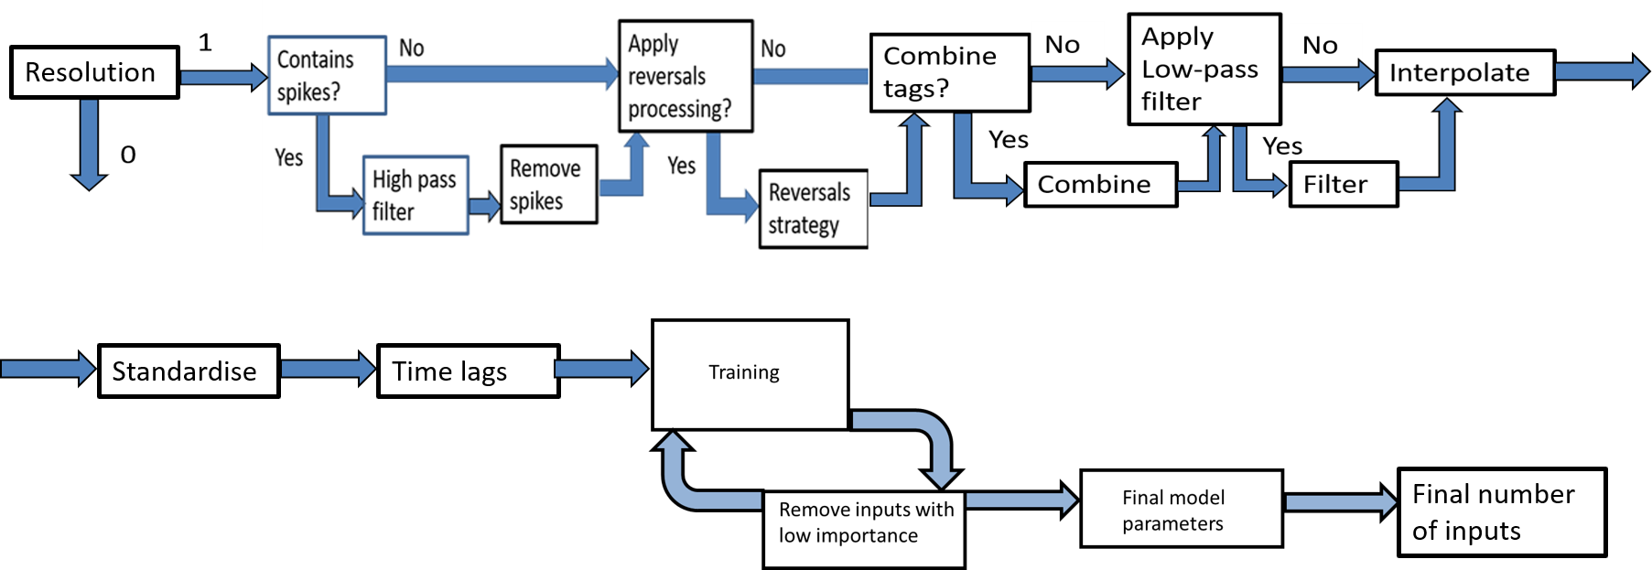
Pipeline 11 using revised outputs (without removing left over spikes)
& Enable?
Yes
Read time lags

Slide 5
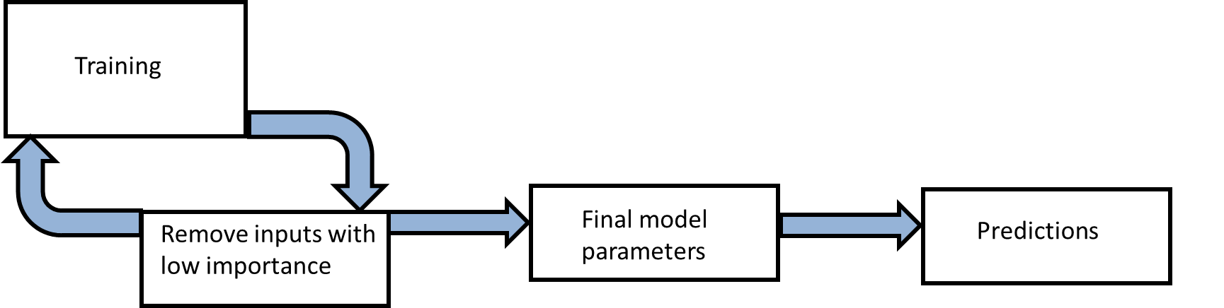
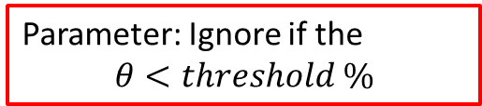
Pipeline 11: Ignoring inputs if their corresponding parameters are below ‘threshold’ %
Standardise
Time lags
Final number of inputs
Parameter: Ignore if the
$$θ<threshold \%$$

Slide 6
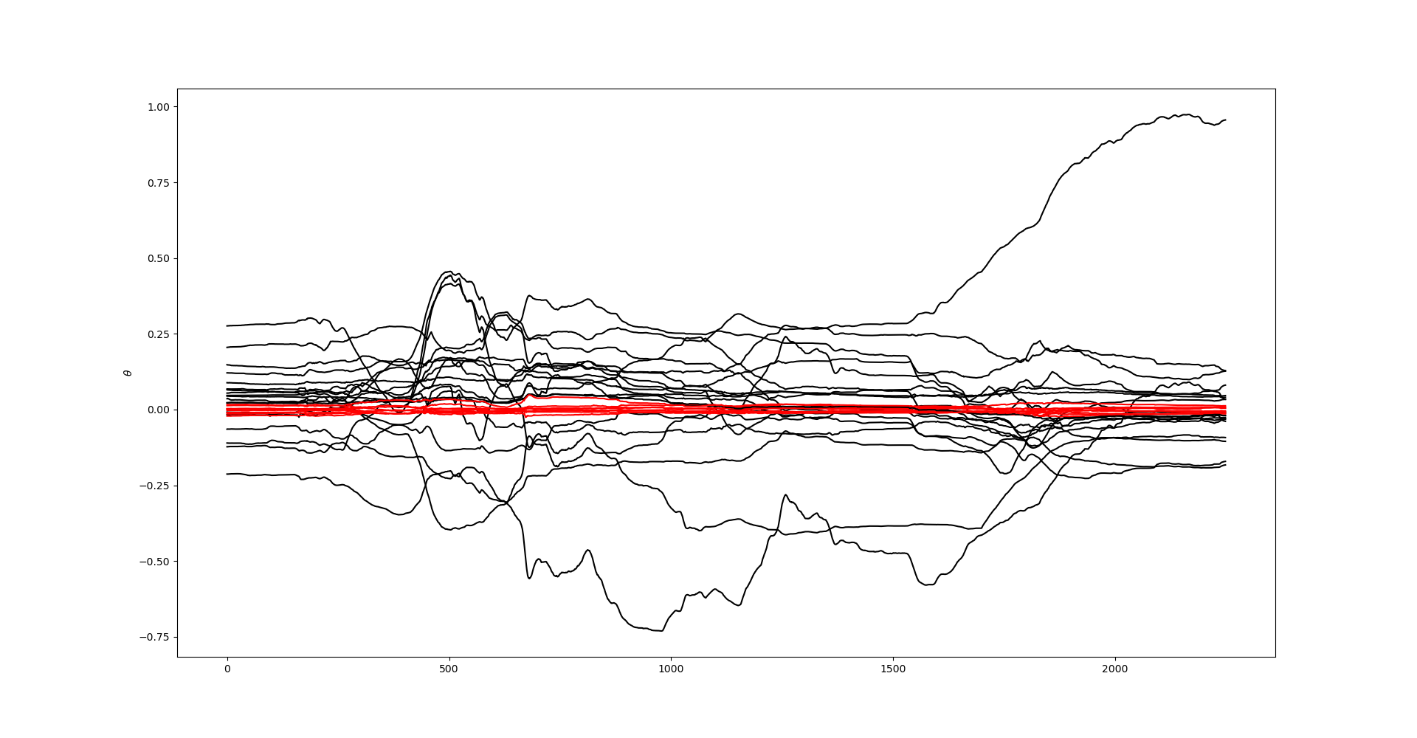
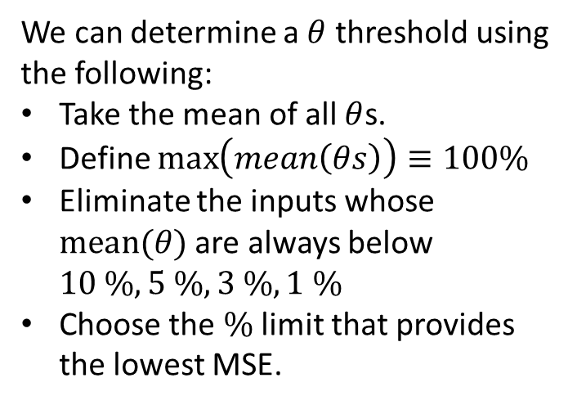
Tuning the $θ$ threshold for eliminating non-relevant tags (ML pipeline)
We can determine a $θ$ threshold using the following:
Take the mean of all $θ$s.
Define $\max\left(mean\left(θs\right)\right)≡100\%$
Eliminate the inputs whose $mean(θ)$ are always below $10 \%, 5 \%, 3 \%,1 \%$
Choose the $\%$ limit that provides the lowest MSE.

Slide 7
List of activities
Implement percentage threshold for eliminating non-relevant tags using the Linear Regression (autoregressive) parameters
Run the Linear Regression (autoregressive) model after eliminating correlated tags
Video with the faults density on top of the predictions
Expand to validation data set
Comprehensive list of pre-processing parameters that could be tuned

Slide 8
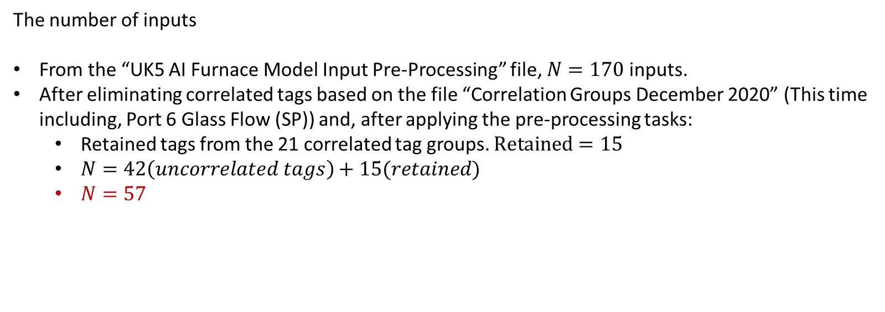
Pipeline 11: Based on the file “Correlation Groups December 2020”
The number of inputs
From the “UK5 AI Furnace Model Input Pre-Processing” file, $N=170$ inputs.
After eliminating correlated tags based on the file “Correlation Groups December 2020” (This time including, Port 6 Glass Flow (SP)) and, after applying the pre-processing tasks:
Retained tags from the 21 correlated tag groups. $Retained=15$
$N=42\left(uncorrelated tags\right)+15(retained)$
$N=57$

Slide 9
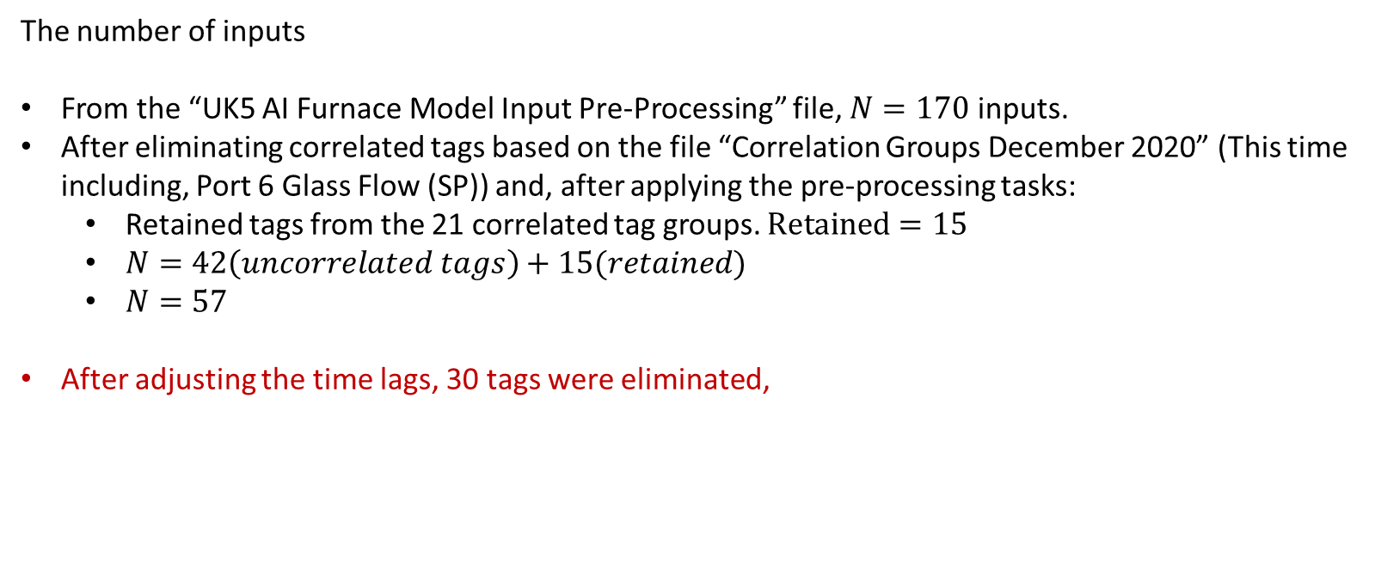
Pipeline 11
The number of inputs
From the “UK5 AI Furnace Model Input Pre-Processing” file, $N=170$ inputs.
After eliminating correlated tags based on the file “Correlation Groups December 2020” (This time including, Port 6 Glass Flow (SP)) and, after applying the pre-processing tasks:
Retained tags from the 21 correlated tag groups. $Retained=15$
$N=42\left(uncorrelated tags\right)+15(retained)$
$N=57$
After adjusting the time lags, 30 tags were eliminated,

Slide 10
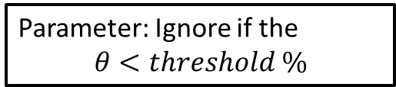
Pipeline 11: Ignore tags whose time lags are < 15 hours
Standardise
Time lags
Final number of inputs
Parameter: Ignore if the
$$θ<threshold \%$$

Slide 11
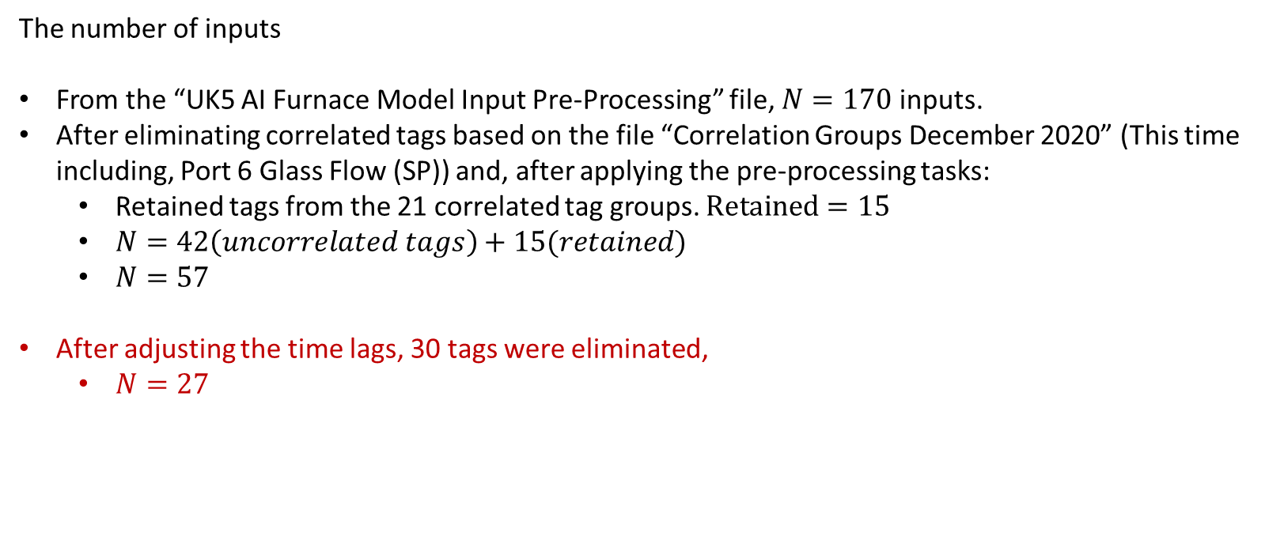
Pipeline 11
The number of inputs
From the “UK5 AI Furnace Model Input Pre-Processing” file, $N=170$ inputs.
After eliminating correlated tags based on the file “Correlation Groups December 2020” (This time including, Port 6 Glass Flow (SP)) and, after applying the pre-processing tasks:
Retained tags from the 21 correlated tag groups. $Retained=15$
$N=42\left(uncorrelated tags\right)+15(retained)$
$N=57$
After adjusting the time lags, 30 tags were eliminated,
$N=27$

Slide 12
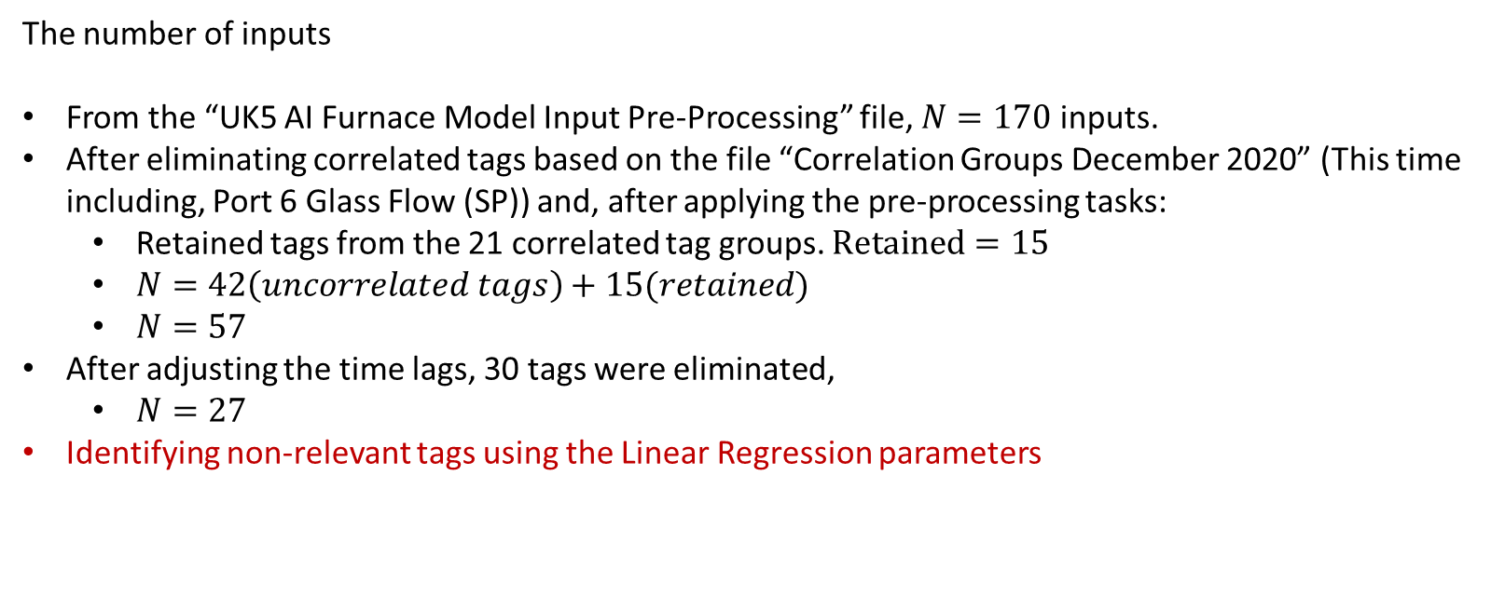
Pipeline 11
The number of inputs
From the “UK5 AI Furnace Model Input Pre-Processing” file, $N=170$ inputs.
After eliminating correlated tags based on the file “Correlation Groups December 2020” (This time including, Port 6 Glass Flow (SP)) and, after applying the pre-processing tasks:
Retained tags from the 21 correlated tag groups. $Retained=15$
$N=42\left(uncorrelated tags\right)+15(retained)$
$N=57$
After adjusting the time lags, 30 tags were eliminated,
$N=27$
Identifying non-relevant tags using the Linear Regression parameters

Slide 13
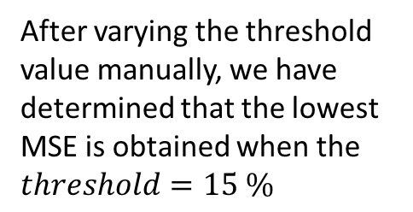

Ignoring inputs if their corresponding parameters are below ‘threshold’ %
Standardise
Time lags
Final number of inputs
After varying the threshold value manually, we have determined that the lowest MSE is obtained when the $threshold=15 \%$
Parameter: Ignore if the
$$θ<15 \%$$
Pipeline 11

Slide 14
The parameters that are close to zero indicate non-relevant tags
Tags identified as non-relevant:
10091 Furnace Load
15119 Furnace Pressure (PV)
9393 Glass Level Control (OP)
321 Glass Level Control (PV)
7474 Lehr Drive Line Shaft Speed
9395 Main Gas Pressure (OP)
6463 Main Gas Pressure (PV)
7546 Open Crown Temperature - Port 1 (PV)
7673 Open Crown Temperature - Port 5 (PV)
N of eliminated tags: 9

Slide 15
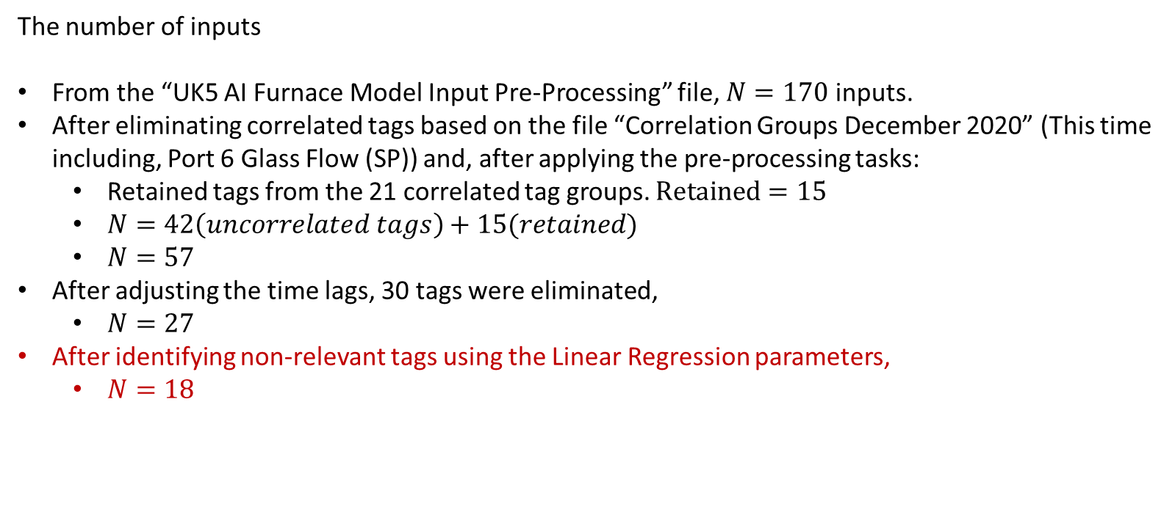
Pipeline 11
The number of inputs
From the “UK5 AI Furnace Model Input Pre-Processing” file, $N=170$ inputs.
After eliminating correlated tags based on the file “Correlation Groups December 2020” (This time including, Port 6 Glass Flow (SP)) and, after applying the pre-processing tasks:
Retained tags from the 21 correlated tag groups. $Retained=15$
$N=42\left(uncorrelated tags\right)+15(retained)$
$N=57$
After adjusting the time lags, 30 tags were eliminated,
$N=27$
After identifying non-relevant tags using the Linear Regression parameters,
$N=18$

Slide 16
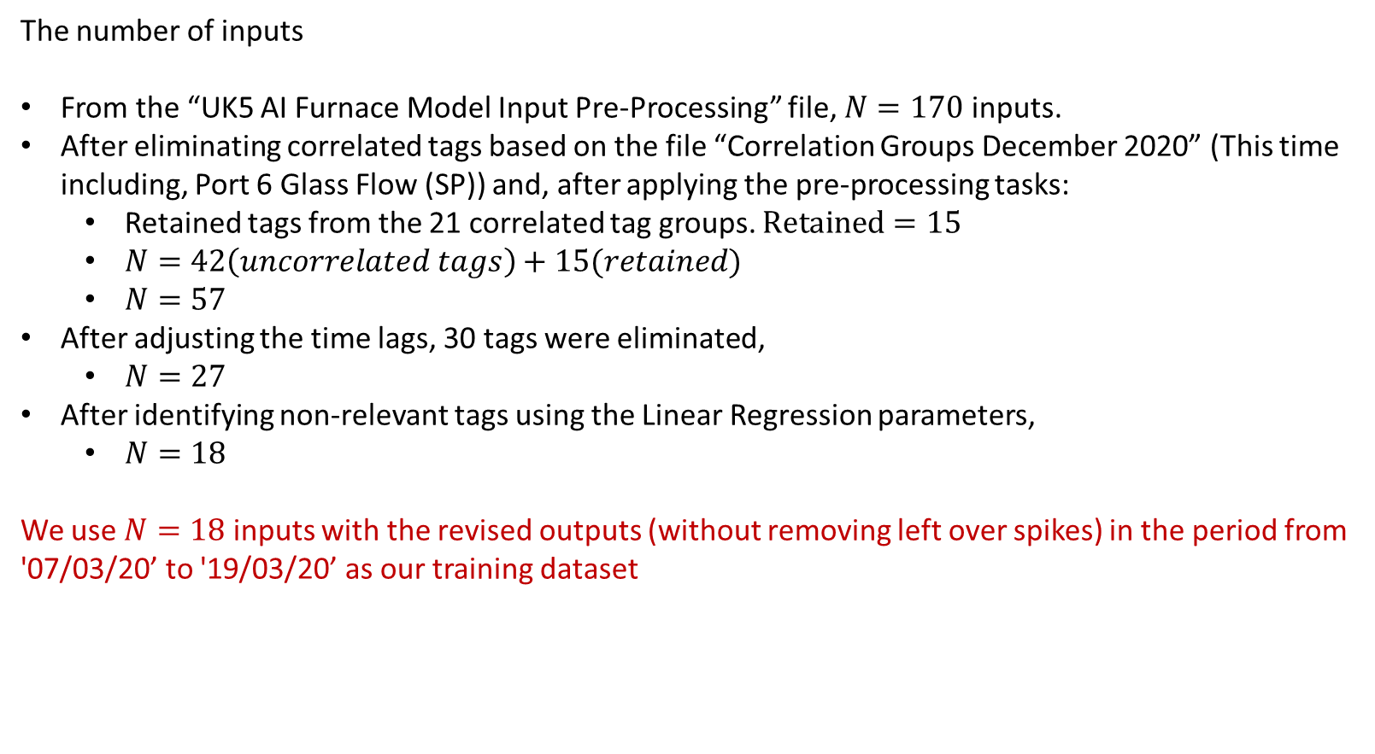
Pipeline 11
The number of inputs
From the “UK5 AI Furnace Model Input Pre-Processing” file, $N=170$ inputs.
After eliminating correlated tags based on the file “Correlation Groups December 2020” (This time including, Port 6 Glass Flow (SP)) and, after applying the pre-processing tasks:
Retained tags from the 21 correlated tag groups. $Retained=15$
$N=42\left(uncorrelated tags\right)+15(retained)$
$N=57$
After adjusting the time lags, 30 tags were eliminated,
$N=27$
After identifying non-relevant tags using the Linear Regression parameters,
$N=18$
We use $N=18$ inputs with the revised outputs (without removing left over spikes) in the period from '07/03/20’ to '19/03/20’ as our training dataset

Slide 17
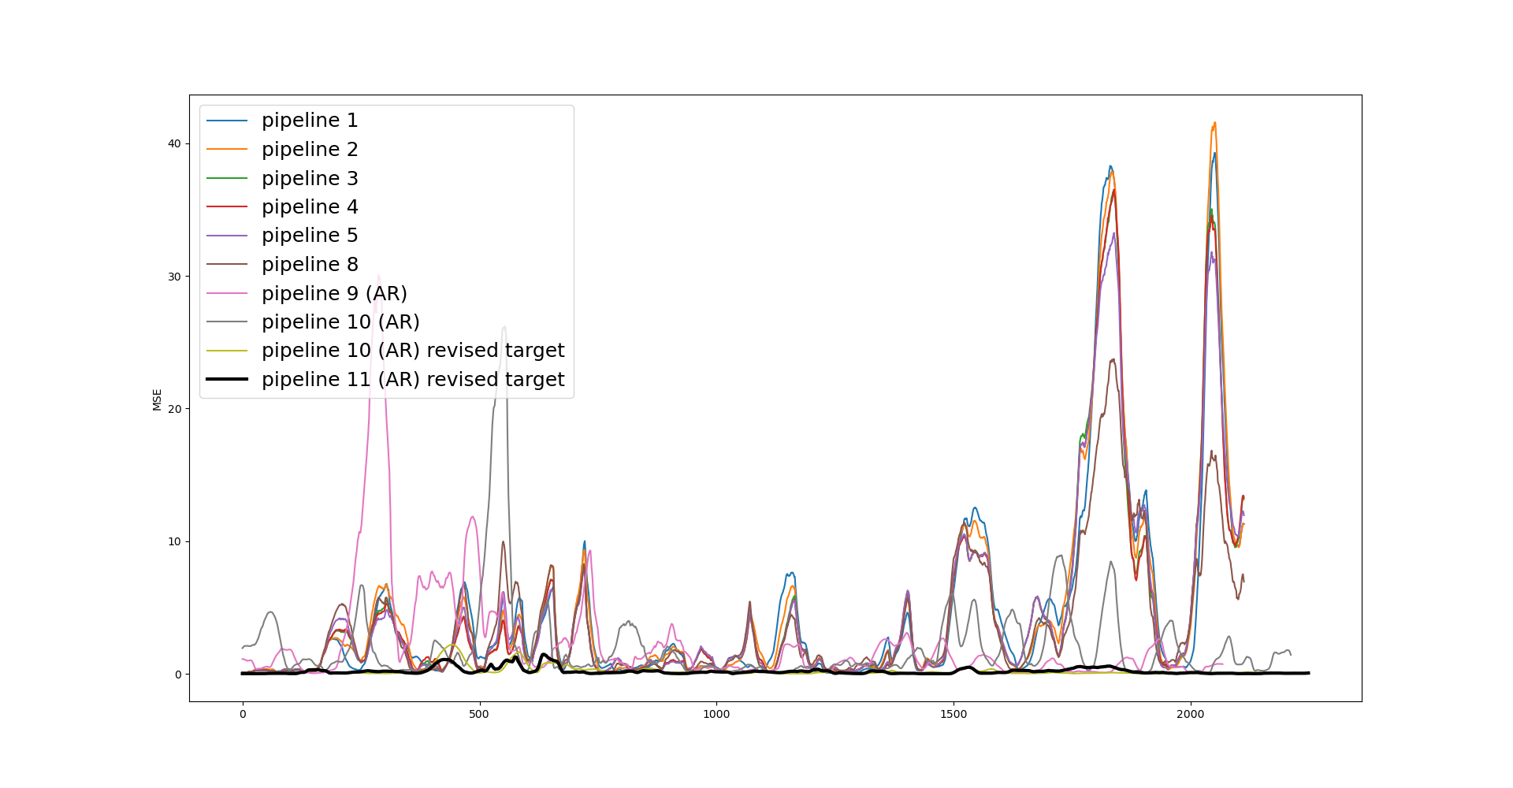
MSE plot comparisons
Pipeline | Av. RMSE
1 | 4.59
2 | 4.70
3 | 4.31
4 | 4.30
5 | 4.31
6 | 4.50
7 | 4.27
8 | 4.25
9 | 4.18
9 (AR) | 2.39
10 (AR) | 1.99
10 (AR) revised target | 0.193
11 (AR) revised target | 0.193

Slide 18
MSE plot comparisons
Pipeline | Av. RMSE
1 | 4.59
2 | 4.70
3 | 4.31
4 | 4.30
5 | 4.31
6 | 4.50
7 | 4.27
8 | 4.25
9 | 4.18
9 (AR) | 2.39
10 (AR) | 1.99
10 (AR) revised target | 0.193
11 (AR) revised target | 0.193
No significant difference between using the correlated inputs (10 revised target) and the uncorrelated inputs (11 revised target). (Using the MSE as an indicator)

Slide 19
Relevant inputs from pipeline 10 (revised target)
Tags retained by the team in the correlation analysis
'10425 Calculated Cullet Ratio’,
'2909 Closed Bottom Temperature - Downstream Refiner (PV)',
'2908 Closed Bottom Temperature - Mid Refiner (PV)’,
'2916 Closed Bottom Temperature - Port 4 (PV)',
'2918 Closed Bottom Temperature - Port 6 (PV)',
'1672 Closed Bottom Temperature - Port 8 (PV)',
'2907 Closed Bottom Temperature - Upstream Refiner (PV)',
'2911 Filling Pocket Closed Bottom Temperature LHS (PV)',
'2912 Filling Pocket Closed Bottom Temperature RHS (PV)',
'11201 Furnace & Services Pack Sub S8 L.H. Section - HV13',
'10091 Furnace Load', '7525 Open Crown Temperature - Port 7 (PV)',
'11148 Open Crown Temperature - Port 8 (PV)',
'10271 Open Crown Temperature - Upstream Refiner (PV)',
'9402 Port 1 Gas Flow (SP)', '9398 Port 3 Gas Flow (SP)',
'11120 Port 4 - 5 Combustion Air Flow RHS (OP)',
'7667 Port 7 Gas Flow (PV)', '9502 Port 7 Gas Flow (SP)',
'11136 Port 8 Gas Flow (PV)', '11137 Port 8 Gas Flow (SP)',
'11217 Services Building MCC9 Cat 'B' Supply - MV60'
7746 Open Crown Temperature - Port 2 (PV)
7673 Open Crown Temperature - Port 5 (PV)
7525 Open Crown Temperature - Port 7 (PV)
10271 Open Crown Temperature - Upstream Refiner (PV)
7945 Open Crown Temperature - Downstream Working End (PV)
2913 Closed Bottom Temperature - Port 1 (PV)
2918 Closed Bottom Temperature - Port 6 (PV)
2909 Closed Bottom Temperature - Downstream Refiner (PV)
2921 Closed Bottom Temperature - Upstream Working End (PV)
9400 Port 2 Gas Flow (SP)
9502 Port 7 Gas Flow (SP)
11137 Port 8 Gas Flow (SP)
1650 Combustion Air Temperature Measurement
11301 UK5 Total Load (Power)
11213 Essential Services Board Cat 'B' Supply - MV53
Common tags

Slide 20
Relevant inputs from pipeline 10 (revised target)
Relevant inputs from pipeline 11 (revised target)
'10425 Calculated Cullet Ratio’,
'2909 Closed Bottom Temperature - Downstream Refiner (PV)',
'2908 Closed Bottom Temperature - Mid Refiner (PV)’,
'2916 Closed Bottom Temperature - Port 4 (PV)',
'2918 Closed Bottom Temperature - Port 6 (PV)',
'1672 Closed Bottom Temperature - Port 8 (PV)',
'2907 Closed Bottom Temperature - Upstream Refiner (PV)',
'2911 Filling Pocket Closed Bottom Temperature LHS (PV)',
'2912 Filling Pocket Closed Bottom Temperature RHS (PV)',
'11201 Furnace & Services Pack Sub S8 L.H. Section - HV13',
'10091 Furnace Load', '7525 Open Crown Temperature - Port 7 (PV)',
'11148 Open Crown Temperature - Port 8 (PV)',
'10271 Open Crown Temperature - Upstream Refiner (PV)',
'9402 Port 1 Gas Flow (SP)', '9398 Port 3 Gas Flow (SP)',
'11120 Port 4 - 5 Combustion Air Flow RHS (OP)',
'7667 Port 7 Gas Flow (PV)', '9502 Port 7 Gas Flow (SP)',
'11136 Port 8 Gas Flow (PV)', '11137 Port 8 Gas Flow (SP)',
'11217 Services Building MCC9 Cat 'B' Supply - MV60'
'10425 Calculated Cullet Ratio',
'2913 Closed Bottom Temperature - Port 1 (PV)',
'2918 Closed Bottom Temperature - Port 6 (PV)',
'2921 Closed Bottom Temperature - Upstream Working End (PV)',
'30208 Feeder Speed Measurement Left',
'11174 Furnace Bottom Temperature 18m D/S of B8',
'7546 Open Crown Temperature - Port 1 (PV)',
'7746 Open Crown Temperature - Port 2 (PV)',
'7673 Open Crown Temperature - Port 5 (PV)',
'7483 Open Crown Temperature - Port 6 (PV)',
'7443 Outside Ambient Temperature Measurement',
'11105 Port 1 Combustion Air Flow LHS (OP)',
'11108 Port 1 Combustion Air Flow RHS (OP)',
'11111 Port 2 - 3 Combustion Air Flow LHS (OP)',
'11114 Port 2 - 3 Combustion Air Flow RHS (OP)',
'9400 Port 2 Gas Flow (SP)',
'11146 Regenerator Base Temperature Port 8 LHS',
'15070 Regenerator Crown Temperature Port 6 RHS'
Common tags

Slide 21
List of activities
Implement percentage threshold for eliminating non-relevant tags using the Linear Regression (autoregressive) parameters
Run the Linear Regression (autoregressive) model after eliminating correlated tags
Video with the faults density on top of the predictions
Expand to validation data set
Comprehensive list of pre-processing parameters that could be tuned

Slide 22
Furnace Fault Pipeline
Low pass filter parameters
Isolate to be between 21/09/19 and 25/10/29
20201202 ISRA-5D 20190801 to 20200322.xlsx
Remove spikes
Low pass filter
High pass filter
Spike locations
High pass filter parameters
Outlier definition

Slide 23
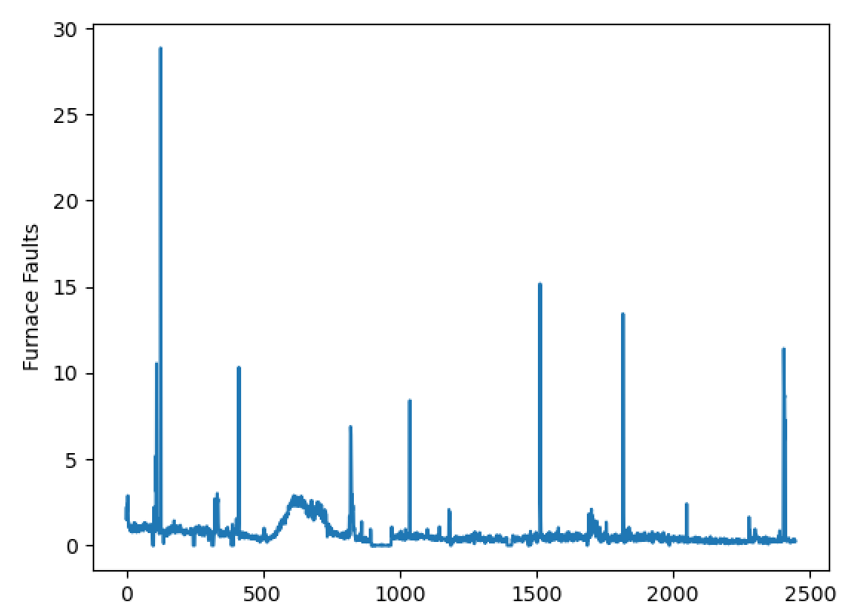
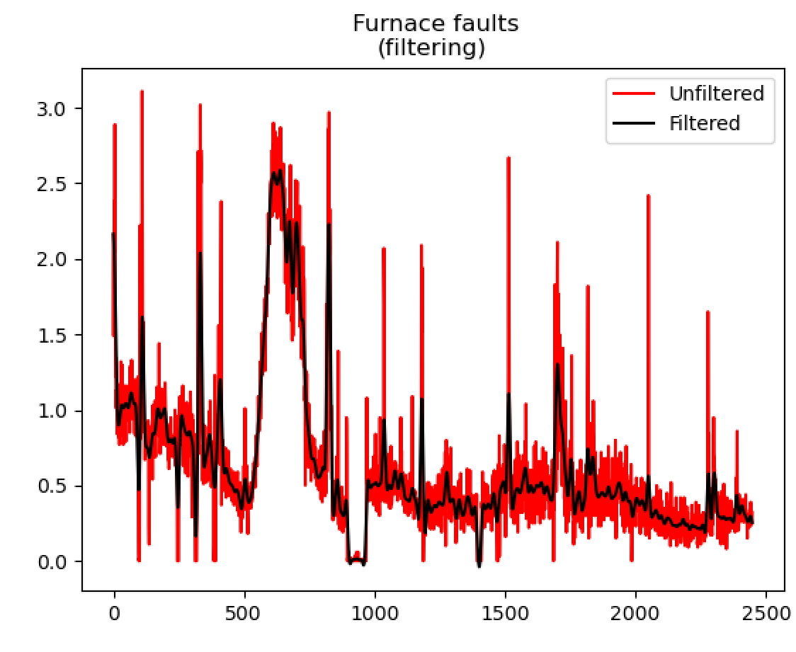
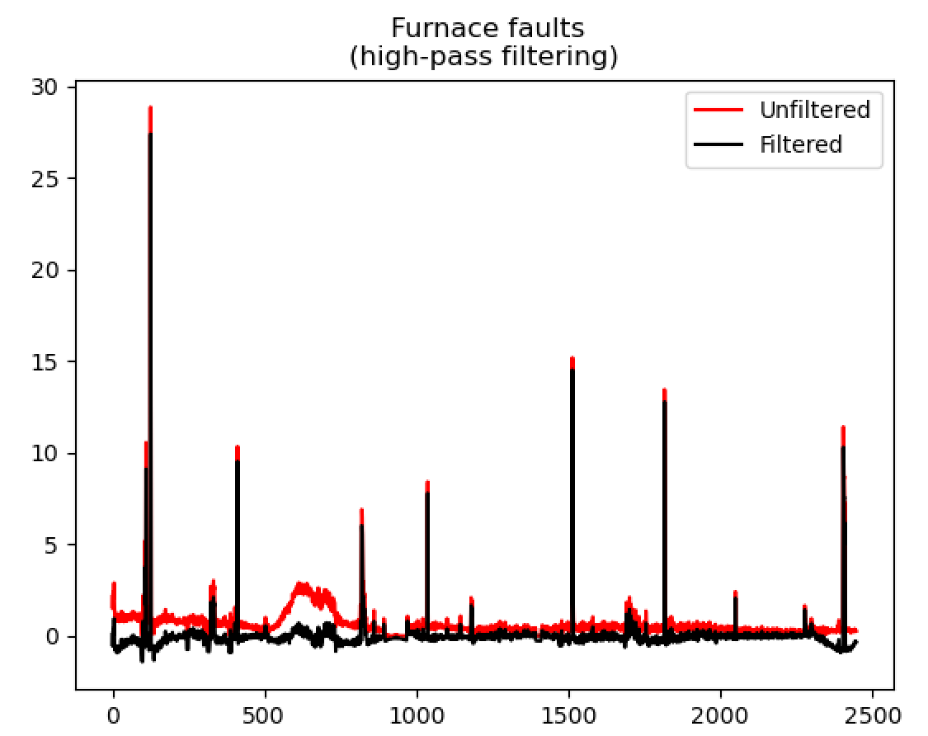
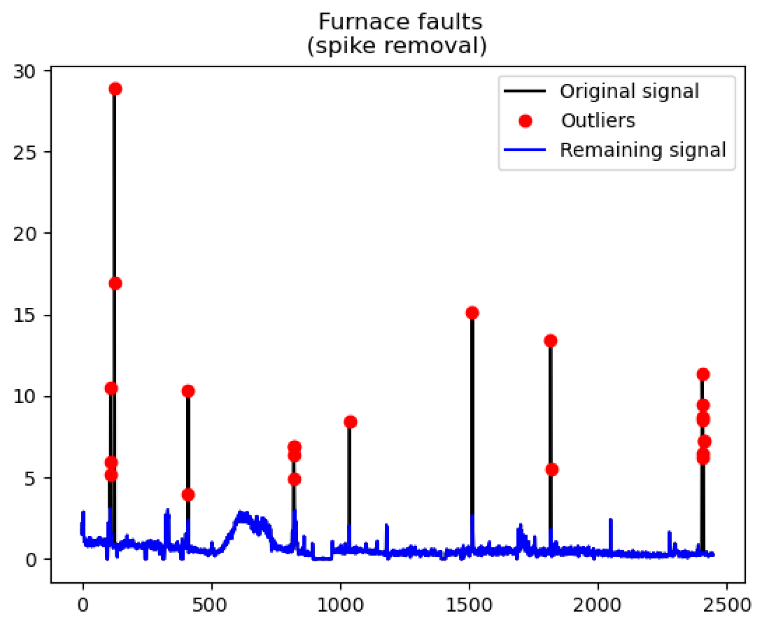
Furnace Fault Pipeline
Isolate to be between 21/09/19 and 25/10/19
20201202 ISRA-5D 20190801 to 20200322.xlsx
Remove spikes
Low pass filter
High pass filter
Spike locations

Slide 24
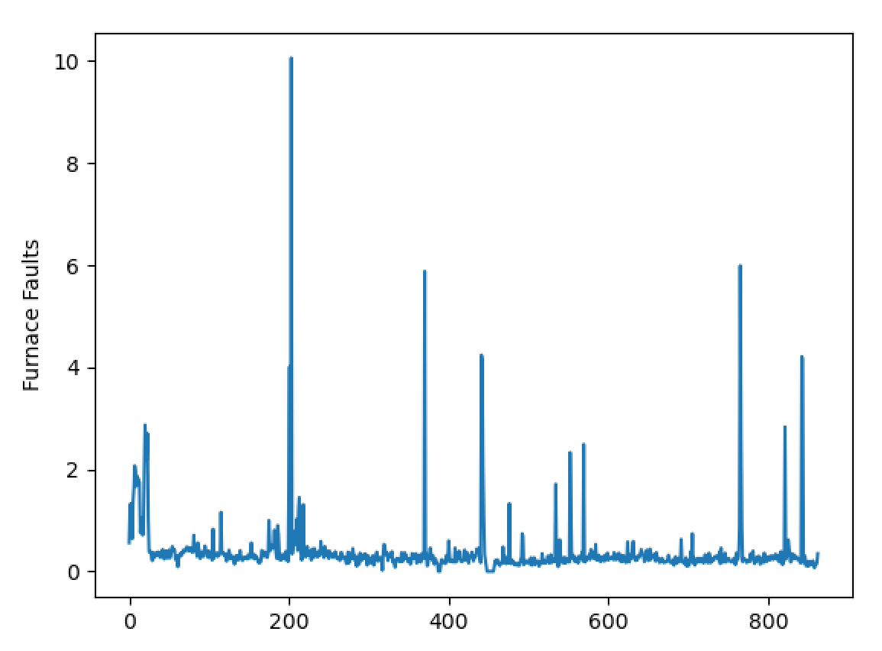
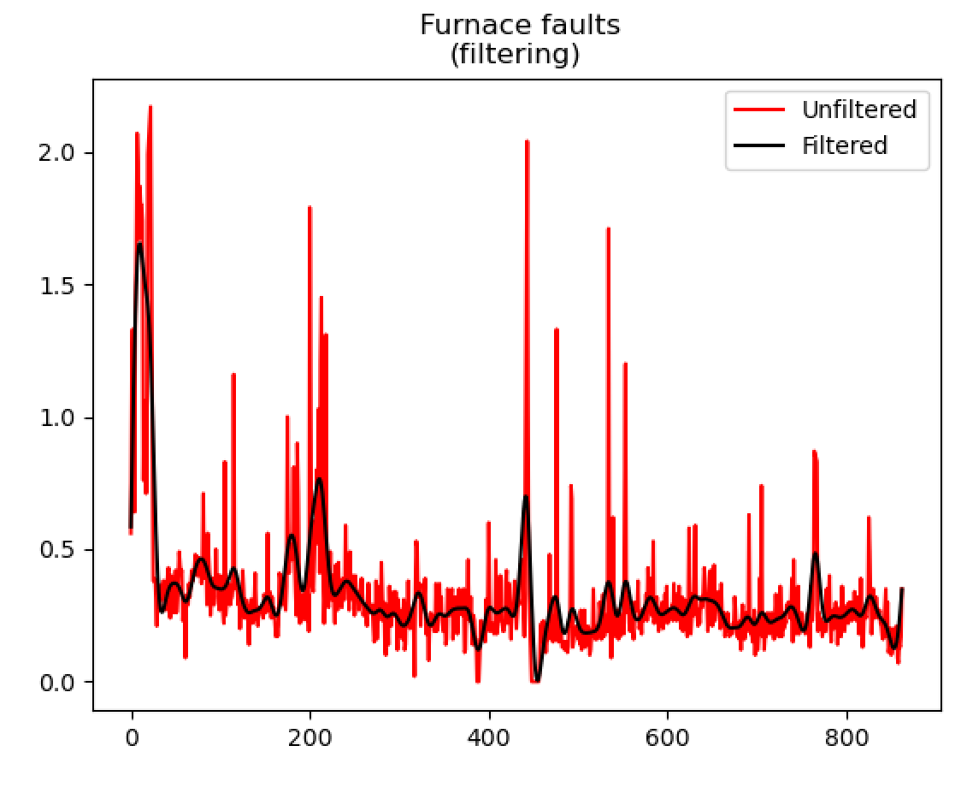
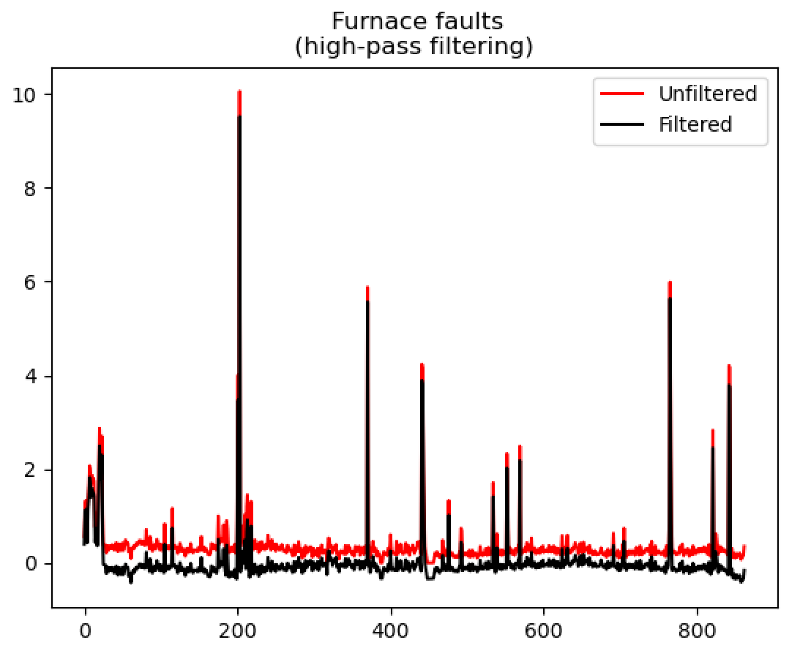
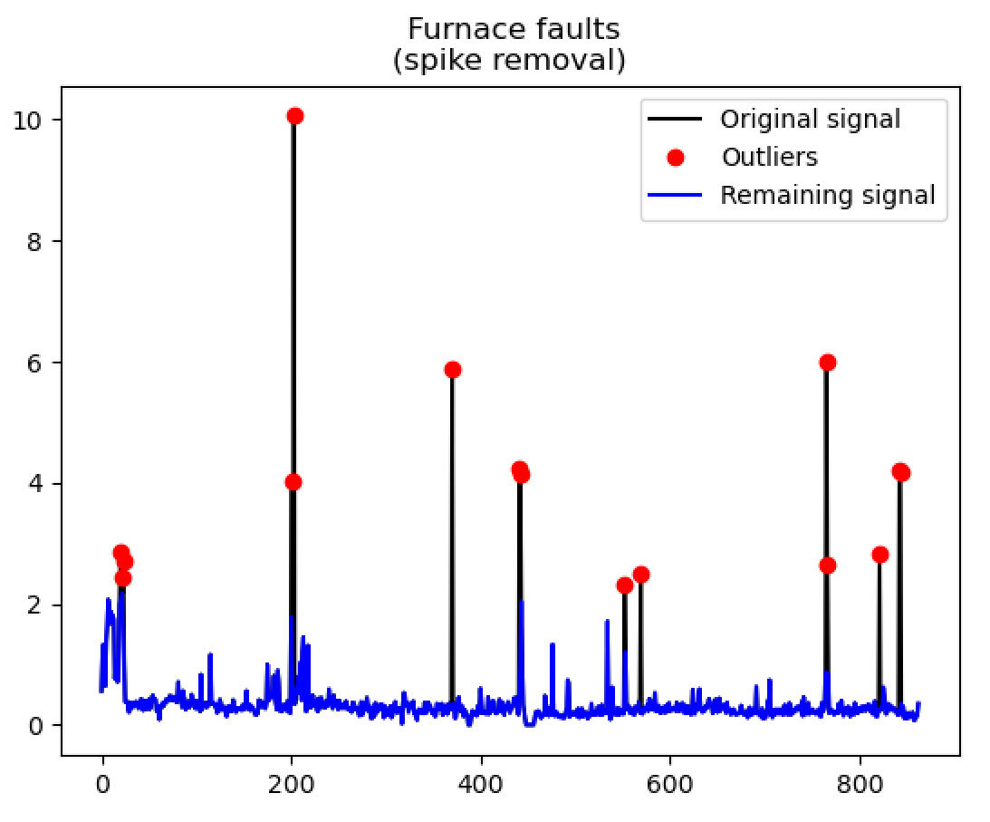
Furnace Fault Pipeline
Isolate to be between 07/03/20 and 19/03/20
20201202 ISRA-5D 20190801 to 20200322.xlsx
Remove spikes
Low pass filter
High pass filter
Spike locations

Slide 25
Available Data
Dataset 1
Dataset 2

Slide 26
Experiment 1
Note that, for now, removing low-importance inputs hasn’t been considered in the experiments.
Dataset 1
Dataset 2
Experiment 1: algorithm directly applied to dataset 2 (initial estimated realised from first 200 points)

Slide 27
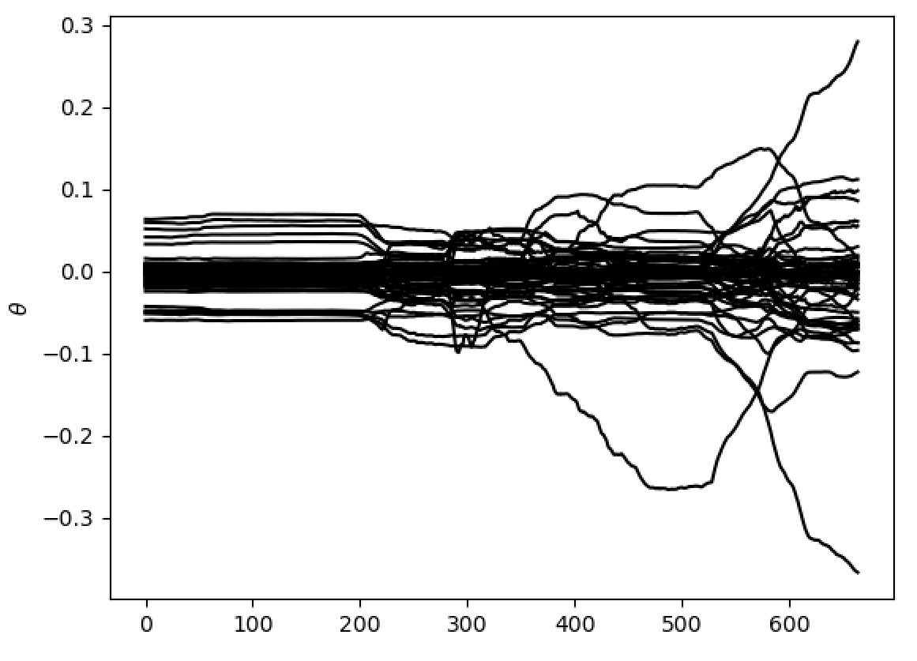
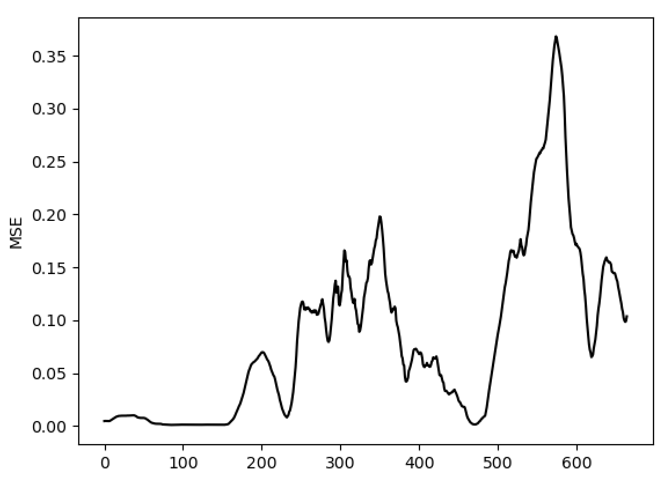
Experiment 1

Slide 28
Experiment 2
Dataset 1
Dataset 2
Experiment 2: train of dataset 1 and test on dataset 2

Slide 29
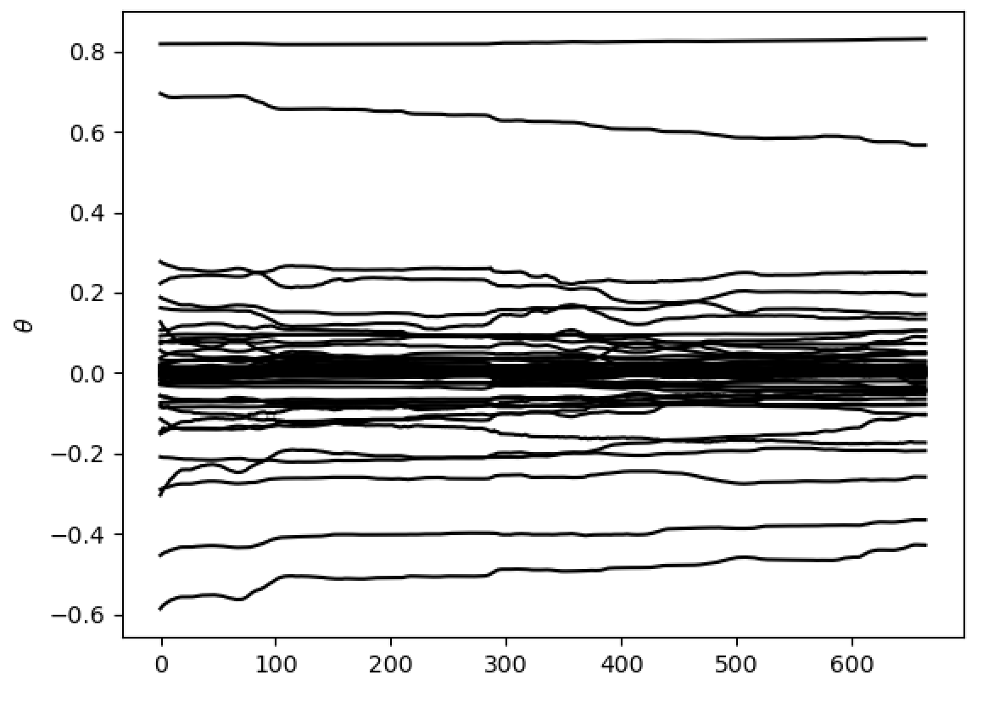
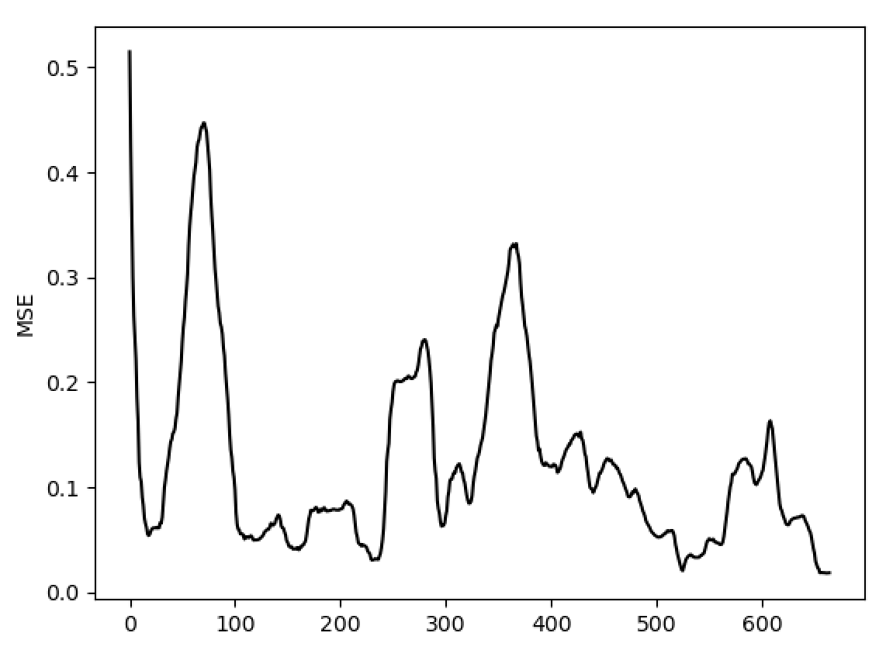
Experiment 1
Experiment 2

Slide 30
Experiment 1
Encouraging to see less parameter variation; implies that the first dataset has provided parameter estimates that still hold on the second dataset.
Experiment 2

Slide 31
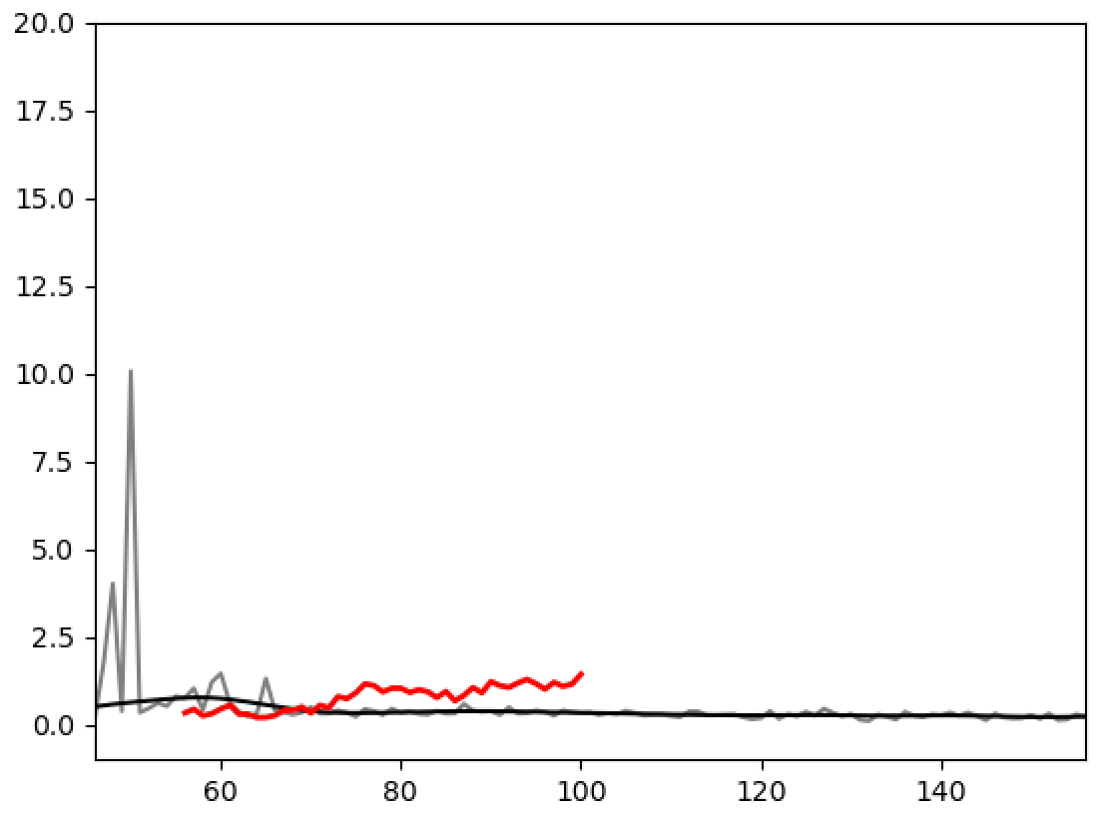
Experiment 2 Video
Pre-processed furnace fault data
Now

Slide 32




Recursive Model Structure
$${\hat{y}}_{t+1}=f_{1}(y_{t}, x^{(t)})$$
$${\hat{y}}_{t+2}=f_{2}({\hat{y}}_{t+1}, x^{(t+1)})$$
$${\hat{y}}_{t+3}=f_{3}({\hat{y}}_{t+2}, x^{(t+2)})$$
$$⋮$$

Slide 33


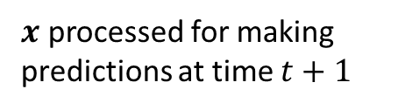

Recursive Model Structure
$x$ processed for making predictions at time $t+1$
$${\hat{y}}_{t+1}=f_{1}(y_{t}, x^{(t)})$$
$${\hat{y}}_{t+2}=f_{2}({\hat{y}}_{t+1}, x^{(t+1)})$$
$${\hat{y}}_{t+3}=f_{3}({\hat{y}}_{t+2}, x^{(t+2)})$$
$$⋮$$
A quick experiment before we move on… How does the first model ($f_{1}$) look at the moment?
The following uses a Gaussian Process that is trained on the first dataset (and is early days!)

Slide 34
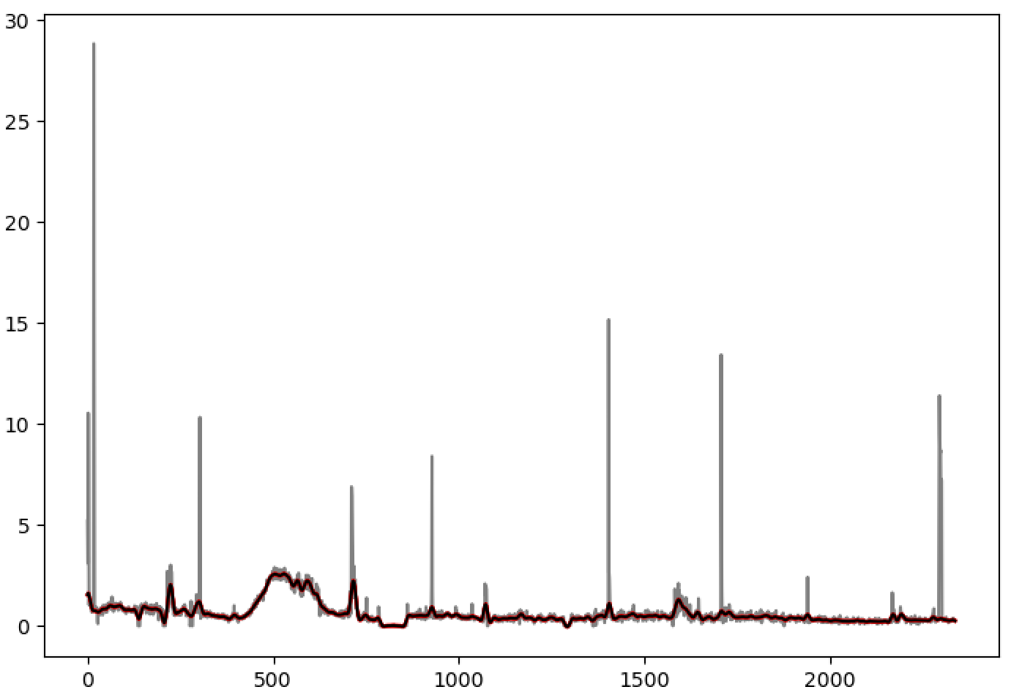
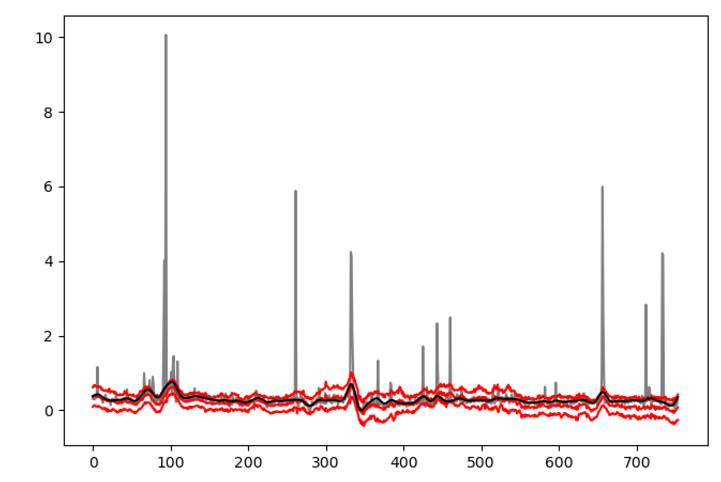
Training
Testing
Given the tuning we can still perform (filter parameters, time lags …); there’s potential here.

Slide 35
List of activities
Implement percentage threshold for eliminating non-relevant tags using the Linear Regression (autoregressive) parameters
Run the Linear Regression (autoregressive) model after eliminating correlated tags
Video with the faults density on top of the predictions
Expand to validation data set
Comprehensive list of pre-processing parameters that could be tuned

Slide 36
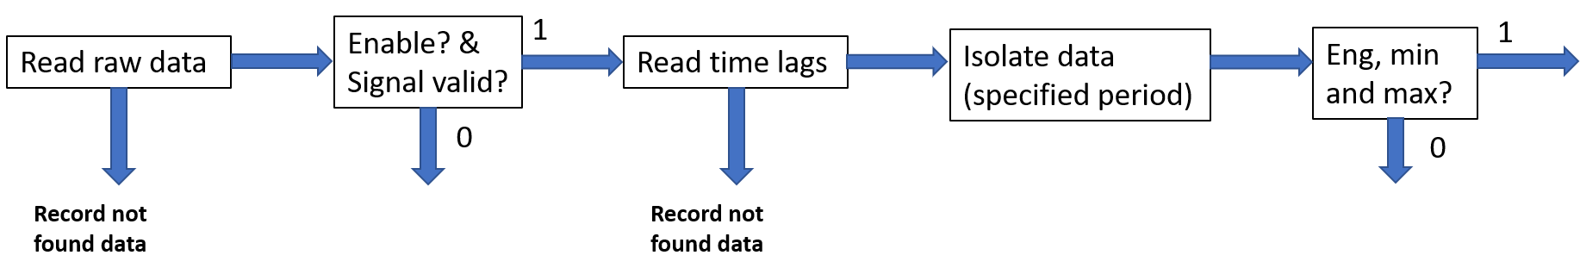
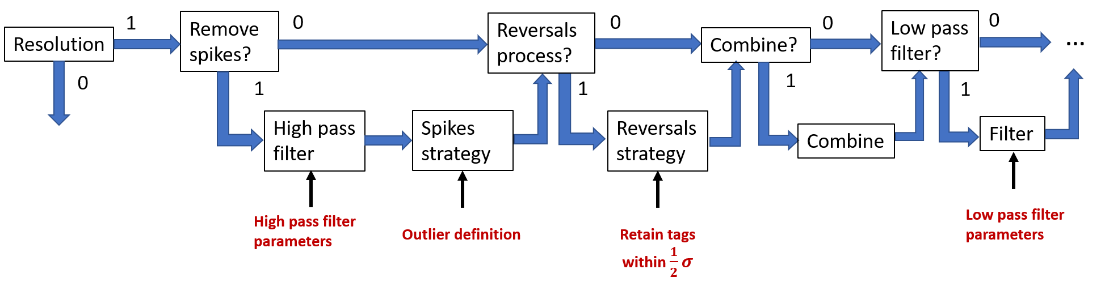
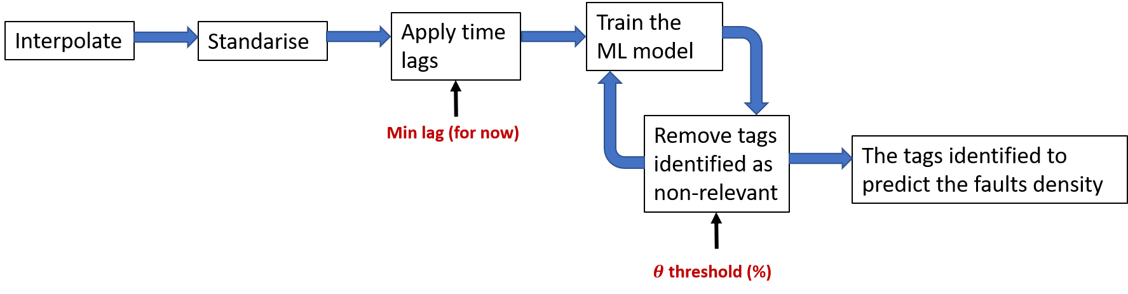

Slide 37
Thank you for your attention. ANY QUESTIONS?

